Slide 1
House Sales Analysis
Team Experimental
Ayushi Singh, Swithin Ruskin Roy, Saloni Kapoor, Sahaj Shukla, Victoria Piskarev, Tianfeng Zhang
Presented by: Professor Thomas Brantle
BIA 654 Experimental Design II
May 14th, 2020
Notes:
Swithin

Slide 2
Outline
Introduction
Data Insights and Sample
Variable Identification
Completely Randomized Design (CRD)
Randomized Block Design (RBD)
Completely Randomized Factorial Design (CRF)
Randomized Block Factorial Design (RBF)
Completely Randomized Analysis of Covariance (CRAC)
Key Results
Notes:
Swithin

Slide 3
Introduction
In this research project, we will be conducting an ANOVA analysis on house sales in Kings County, USA between May 2014 and May 2015. Kings County is a group of cities in Washington State that includes Seattle. We will be using SAS to compute the exploratory data analysis and ANOVA methods and results.
Research Statement:
We wish analyze if the factors Bedrooms and Floors and their treatment levels explain significant variations in prices of houses and to see if there is any significant interaction between the Factors.
Key Issues:
What are the main factors that affect the housing prices?
Is there significance between the combinations of factors that can affect pricing?
Notes:
Swithin

Slide 4
Data Insights
We have discovered an extensive dataset on Kaggle for our project called “Predicting House Prices”
The dataset contained 21 columns and 21,614 rows
Of the 21000 records we had in the dataset, most houses had 1, 1.5 or 2 Floors, 2,3 or 4 Bedrooms. All the houses were graded on a scale of 1 to 12. Most houses fell under grades 7, 8 and 9. So we decided to do our analysis on houses under these categories.
We will be trying to find out if the Factors BEDROOMS and FLOORS have a significant effect on house prices under the 3 Grades
The variables we use for the analysis are:
Bedrooms - This is the number of bedrooms in the house.
Floors - This is a Categorical variable with three levels
Grade - This is also a categorical variable with three levels
Sqft_living - This is a continuous variable
Price - This is the dependent variable and it is Continuous.
Notes:
Victoria
https://www.kaggle.com/burhanykiyakoglu/predicting-house-prices/data
Grade is an evaluation of the construction materials and level of craftmanship used to build houses. The majority of assessors have around 8 to 15 different grades to describe homes. Construction grades can raise or lower property values

Slide 5
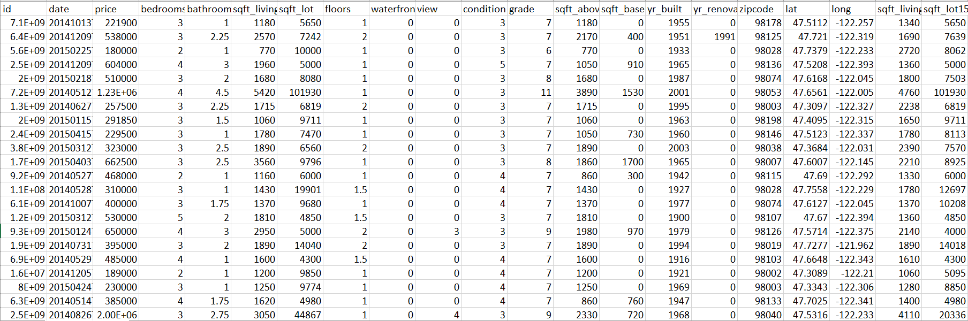
Sample of Raw Data
Source: https://www.kaggle.com/burhanykiyakoglu/predicting-house-prices/data
Notes:
Victoria
Sample rows from our dataset
We cannot use all variables so we use some

Slide 6
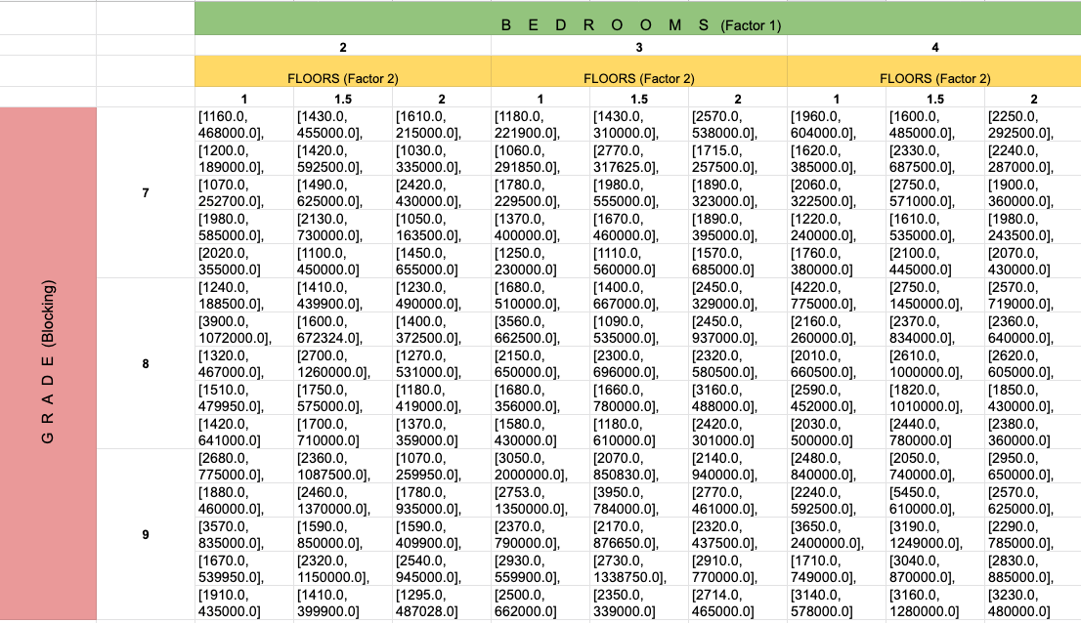
Sample of Data for SAS
Notes:
Victoria
How the data will look going into SAS
The factors we are concerned about bedrooms and floors, each factor has three levels, and we have another factor called grades we are not as concerned as but we used. 3*3*3, 27 * 5 = 135

Slide 7
Variables - Description
Response / dependent variable: Price
We believe this factor will be the most influenced by the other columns in the data, so we chose
price as our dependent variable.
Factors: Bedrooms and Floors
Bedrooms : Has levels 2, 3 and 4
Floors : Has levels 1, 1.5 and 2
Blocking Factor: Grade
We chose Grade as the blocking factor because it can absorb some of the variance in Price and give us a more accurate value for the effect of Bedrooms and Floors on the Price.
Covariate: Square Foot of living
This is a useful covariate because it has a positive correlation with the Price
Notes:
Victoria
Square foot living has a positive co

Slide 8
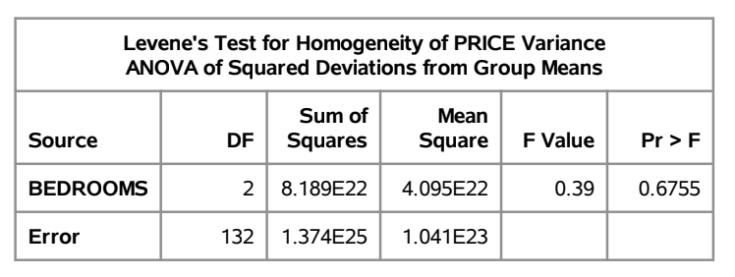
Completely Randomized Design (CRD)
Factor: Bedrooms
We wish to find out if number of Bedrooms have significance. I.e. if the mean prices significantly differ between the 2 bedroom, 3 bedroom and 4 bedroom houses
Null hypothesis:
Ho: μ_{B=2}= μ_{B=3}= μ_{B=4}
Alternate hypothesis:
Ha: μ_{i}≠μ_{j} For at least one combination of i and j
Where i and j represent the number of bedrooms
Homogeneity of Variances:
Levene’s test for Homogeneity gave us a p-value of 0.6755, so our Homogeneity of Variance assumption is tenable
Notes:
Ayushi

Slide 9
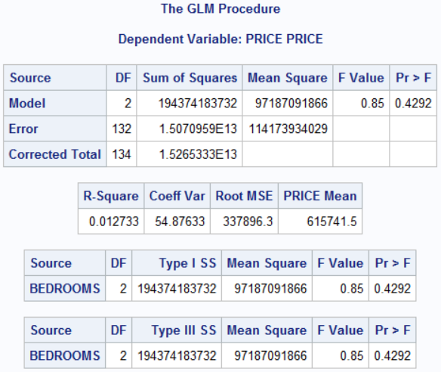
Completely Randomized Design Continued..
We get a p-value of 0.4292 for the Factor Bedrooms, so there is no significance.
Based on the One-Way Anova Results, we conclude that the number of Bedrooms do not significantly affect the House Prices.
In the next design we will be adding a blocking variable to see if our conclusions change
Notes:
Ayushi

Slide 10
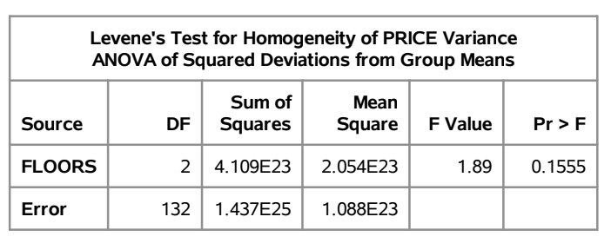
Completely Randomized Design (CRD)
2. Factor: Floors
Next, we wish to find out if number of Floors have significance. I.e. if the mean prices significantly differ between the houses with respect to number of floors
Null hypothesis:
Ho: μ_{F=1}= μ_{F=1.5}= μ_{F=2}
Alternate hypothesis:
Ha: μ_{i}≠μ_{j} For at least one combination of i and j
Where i and j represent the number of Floors
Homogeneity of Variances:
Levene’s test for Homogeneity gave us a p-value of 0.1555, so our Homogeneity of Variance assumption is tenable
Notes:
Ayushi

Slide 11
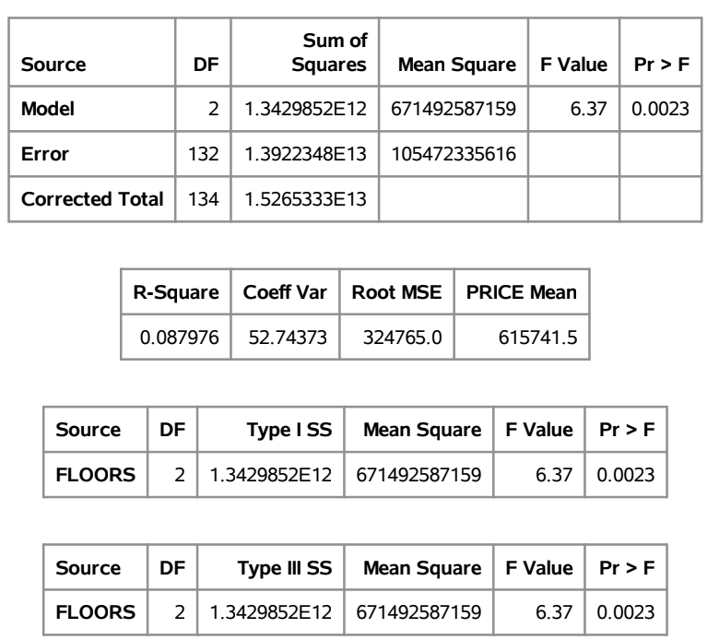
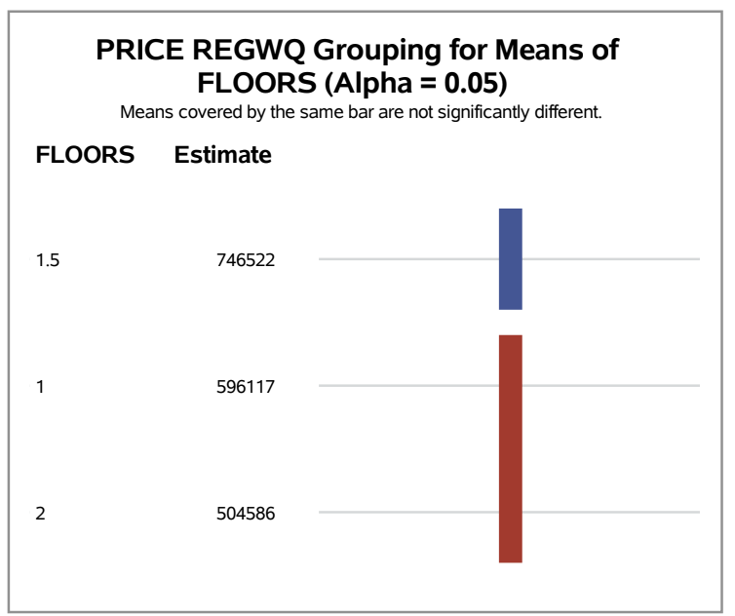
Completely Randomized Design
We get a p-value of 0.0023 for the Factor Bedrooms, so there is significance. So, we reject the Null Hypothesis. We now know that at least one level in Floors is significantly different from another level
We use the REGWQ and Tukey multiple comparisons test to analyse and find out where the source of the significance is.
Based on Both REGWQ and Tukey tests, we conclude that Houses with 1.5 floors have a significantly higher mean price compared to the other two types.
Notes:
Ayushi

Slide 12
Randomized Block Design (RBD)
Our Factor of interest is still Bedrooms, but we add a nuisance variable to see if our conclusions change from the previous design.
The Variable Grade will act as a Blocking Variable in this Design.
Addition of this variable can help us get more accurate insights because this variable will account for some of the variance in Price
As a result, error term is reduced and it projects the influence of the Factor Bedrooms on Price more accurately.
Null Hypothesis:
Ho: μ_{B=2}= μ_{B=3}= μ_{B=4}
Alternative Hypothesis:
Ha: μ_{i}≠μ_{j} For at least one combination of i and j
Where i and j represent the number of bedrooms
.
Notes:
Saloni

Slide 13
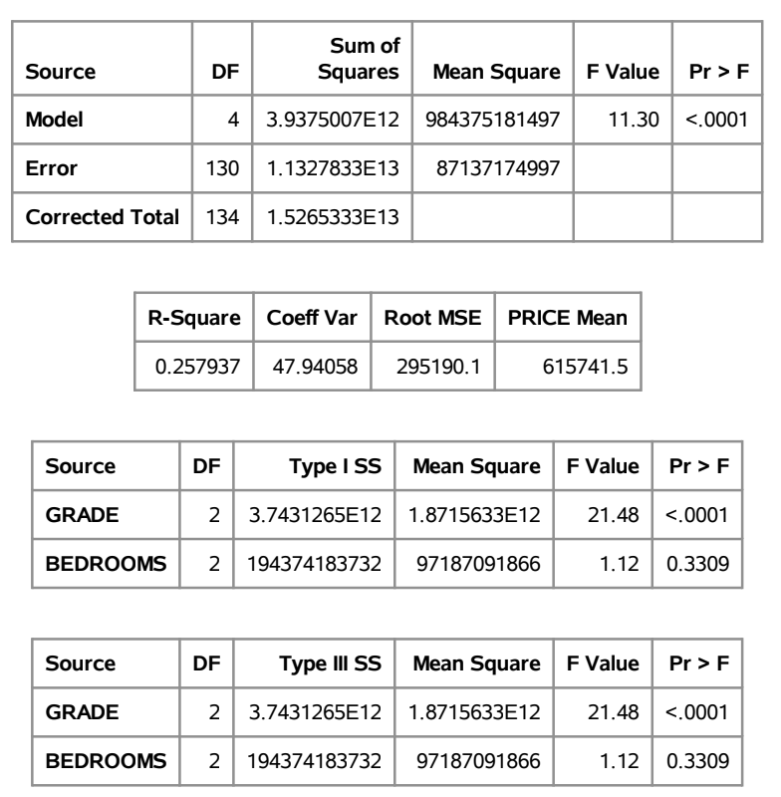
Recommendation & Conclusion
We get a p-value of 0.3309 for the Factor Bedrooms, so there is no significance at α = 0.05
Based on the Two-way Anova Results, we still conclude that the number of Bedrooms do not significantly affect the House Prices.
It has to be noted that the p-value has decreased from 0.4292 after adding the Blocking variable - the number of bedrooms has a comparatively higher affect than was thought earlier.
Notes:
Saloni

Slide 14
Randomized Block Design (RBD)
Our Factor of interest is now Floors, but we add a nuisance variable to see if our conclusions change from the previous design.
The Variable Grade will act as a Blocking Variable in this Design.
Addition of this variable can help us get more accurate insights because this variable will account for some of the variance in Price
As a result, error term is reduced and it projects the influence of the Factor Floors on Price more accurately.
Null Hypothesis:
Ho: μ_{F=1}= μ_{F=1.5}= μ_{F=2}
Alternative Hypothesis:
Ha: μ_{i}≠μ_{j} For at least one combination of i and j
Where i and j represent the number of floors
.
Notes:
Saloni

Slide 15
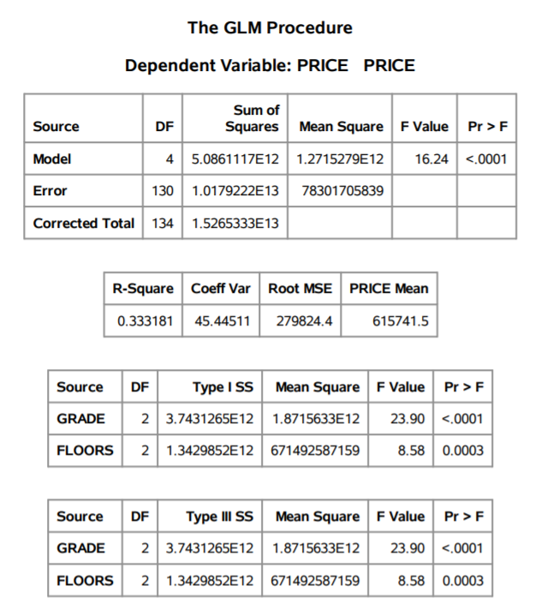
Recommendation & Conclusion
We get a p-value of < 0.001 for the Factor Bedrooms, so there is significance at α = 0.05
Based on the Anova Results, we still conclude that the number of Floors do significantly affect the House Prices.
It has to be noted that the p-value has decreased to less than 0.0001 after adding the Blocking variable - the number of floors has a comparatively higher affect than was thought earlier.
Notes:
Saloni

Slide 16
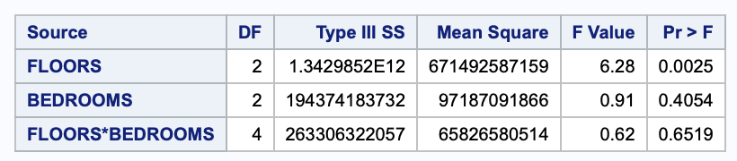
Completely Randomized Factorial Design (CRF)
We used Completely Randomized Factorial Design:
To check for main-effects
If the number of Bedrooms significantly affect mean House Prices.
Null Hypothesis:
Ho: μ_{B=2}= μ_{B=3}= μ_{B=4}
Alternative Hypothesis:
Ha: μ_{i}≠μ_{j}
For at least one combination of i and j
Where i and j represent the number of bedrooms
If the number of Floors significantly affect mean House Prices
Null Hypothesis:
Ho: μ_{F=1}= μ_{F=1.5}= μ_{F=2}
Alternative Hypothesis:
Ha: μ_{i}≠μ_{j}
For at least one combination of i and j
Where i and j represent the number of Floors
B. To check if there’s an interaction between the Factors Floors and Bedrooms.
Null Hypothesis:
Ho: There is no interaction between the two Factors
Alternative Hypothesis:
Ha: There is interaction between the two Factors
Model:
Price = Floors Bedrooms Floors * Bedrooms
Notes:
Victoria
No interaction between variables

Slide 17
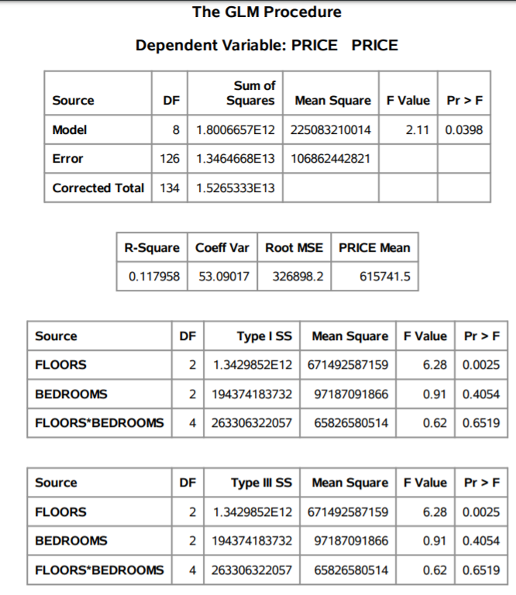
CRF cont.
Normality:
Our Shapiro-Wilk Tests for Normality tell us that House Prices in almost all the combinations of Bedroom levels and Floor levels are normally distributed. So the ‘approximate normality’ assumption for two-way ANOVA is tenable. The normality test p-values for the nine combinations are 0.3909, 0.0013, 0.001, 0.0669, 0.1586, 0.3359, 0.0568, 0.1071, 0.5082
The p-value of 0.0398 in the first table tells us that there is significance in at least one of the treatment levels in at least one of the models.The p-value for the factor Floors (0.0025) tells us that there is significance in at least one of the levels. The p-value for the factor Bedrooms (0.4054) tells us that there is not enough statistical significance in the levels.
Also, the p-value for the interaction is 0.6519. So, there is no significant interaction between Floors and Bedrooms. This means that we can remove the interaction for the ANOVA and we can do a regular two-way ANOVA.

Slide 18
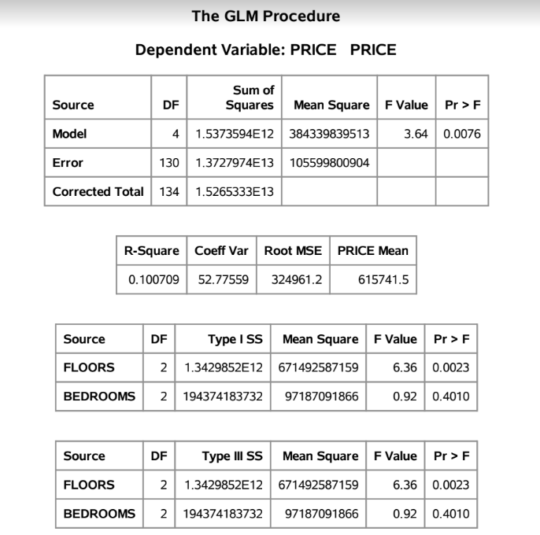
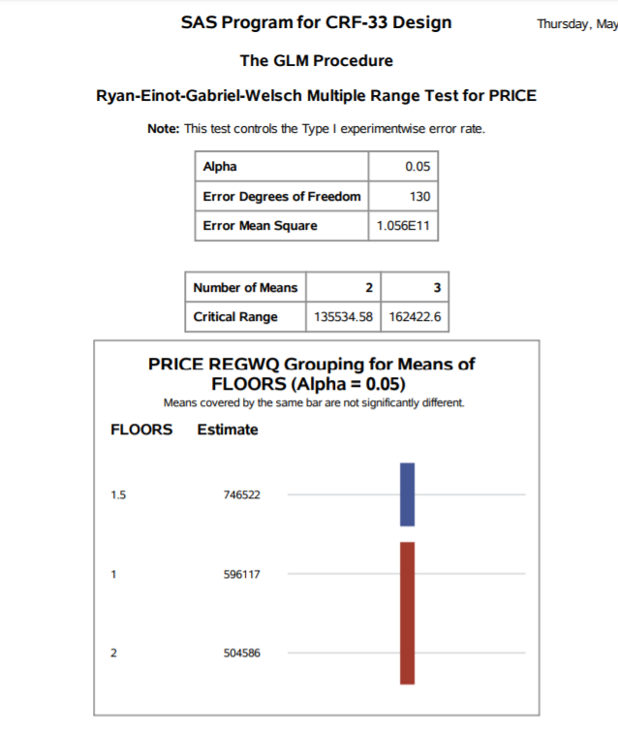
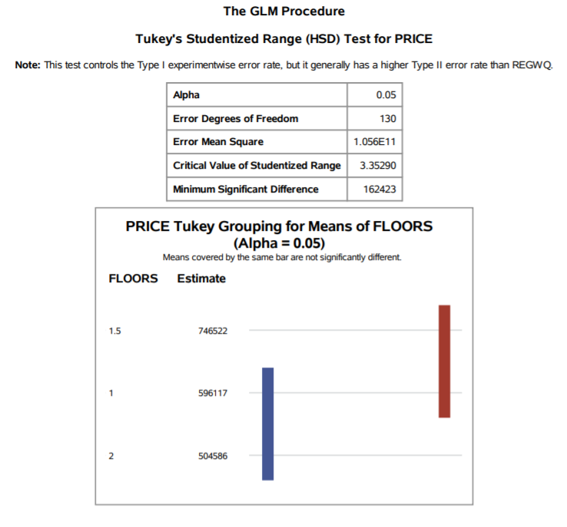
CRF Cont.
We ran the 2 way ANOVA without the interaction, and found that bedrooms p-value is greater than 0.05, which means the bedrooms factor is not statistically significant to explain the changes in house prices. This means we can run a one-way ANOVA, which is just a CRD. We also found through the means comparison that the houses with 1.5 floors have a significantly higher mean.

Slide 19
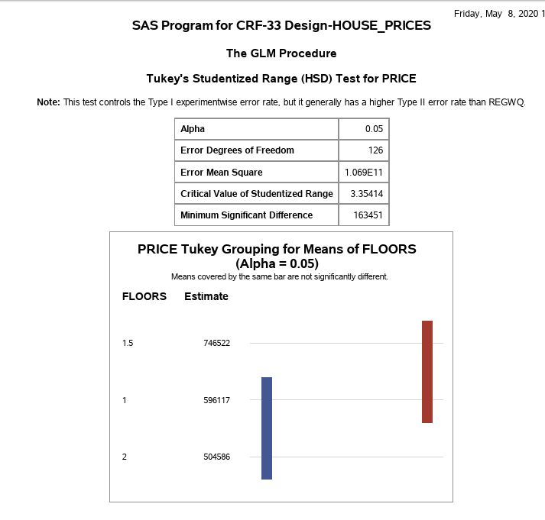
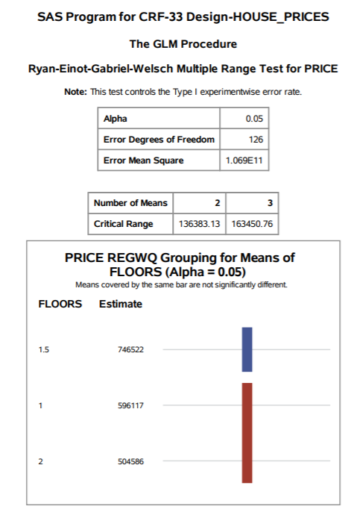
CRF Conclusion
Multiple Comparison
We completed the Tukey and REGWQ tests for a multiple comparison test if the means are equal for the model with an interaction. The graph shows that there is a significant difference in the means between 1.5 levels and 2 levels when alpha is 0.05. This means that a house with 1.5 levels has an average price that is significantly higher than $163,451 than its counterparts with 1 floor or 2 floors. A house with 1 floor has a higher mean price than a house with 2 floors and a lower price than a house with 1.5 floors, but it is not significantly different. These tests have the same conclusions as the means test for the two way ANOVA without an interaction.
Conclusion:
Floors has a significant effect on house prices. Bedroom levels do not have a significant effect on house prices
1.5 Floored Houses tend to have a significantly higher mean price compared to their 1,2 Floored counterparts.
We can remove the interaction and then the bedroom variable to get a significant conclusion from a one way ANOVA

Slide 20
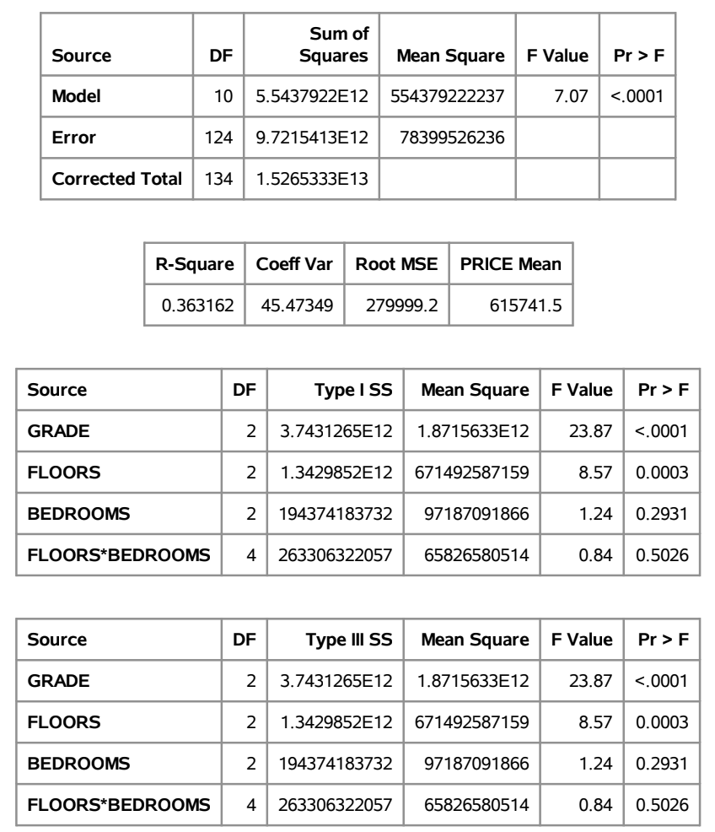
Randomized Block Factorial Design (RBF)
Blocking variable: Grade
Factors: Bedrooms, Floors
Ha = i ≠ j for at least one combination.
Initially, we conduct the analysis to check if there is significance due to levels in any of the two factors.
Namely, bedrooms and floors.
OMNIBUS ANOVA RESULTS:
MODEL P-VALUE : <0.001
Interaction P-Value : 0.5026 (Not significant) . There is no interaction
P value for Inter class contribution for ‘Floors’: 0.0003 (significant)
P value for Inter class contribution for ‘Bedrooms’: 0.2931 (Not significant)
We assume normality in this case.
Notes:
Sahaj

Slide 21
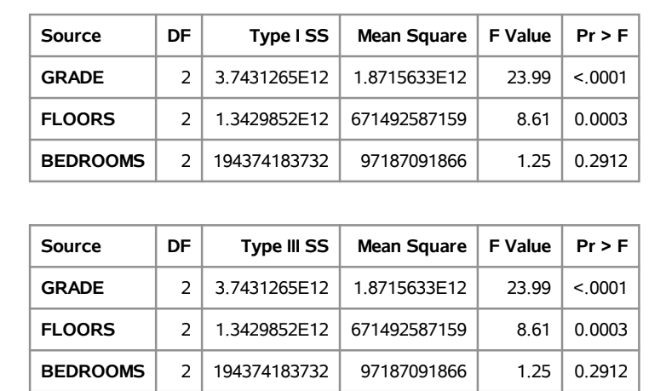
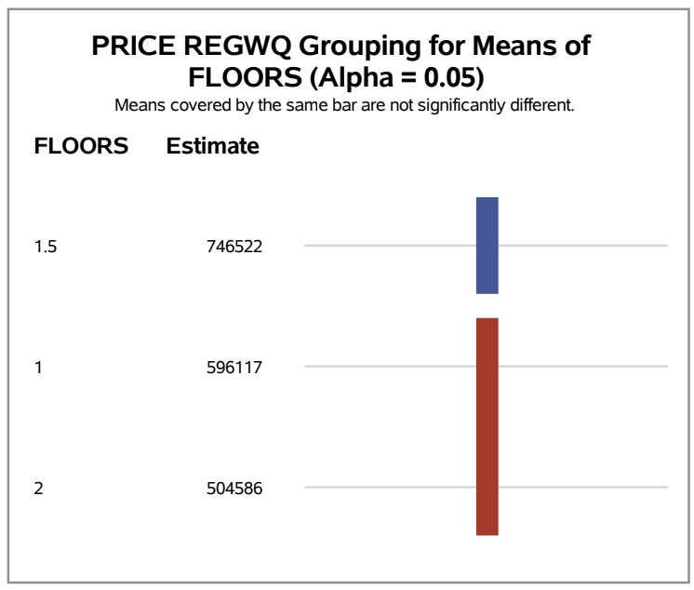
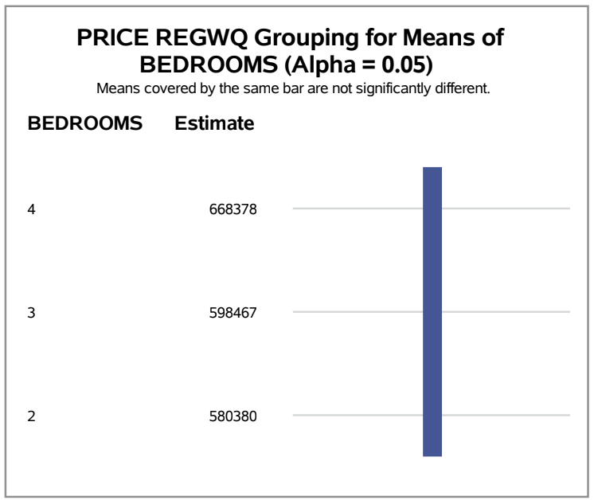
RBF Post-Hoc Results
Since our interaction is insignificant, we run an ANOVA model without the interaction. We find that Bedrooms doesn't have significance and Floors does with a p-value of 0.0003. We reject the null hypothesis for main effects Floors
When we remove the insignificant factor Floors from the model, it becomes a Randomized Block Design which we did earlier and inferred that Floors had a significant effect on the Price and Houses with 1.5 Floors had a significantly higher price compared to the other types.
Anyway, the post-hoc tests in the model with both the Factors give us the same output
Notes:
Sahaj

Slide 22
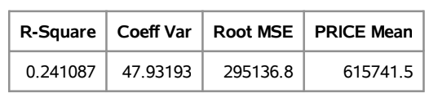
CRAC (Completely Randomized Analysis of Covariance)
Factor: Floors Covariate: Sqft_living
Factor: Floors
Covariate: Sqft_living
Dependent Variable : Price
Our covariate has a positive pearson correlation coefficient of 0.495 (R_Squared : 0.241 ) with the dependent variable Price
We wish to see if the factor Floors still has a significant effect on Price after accounting for the effects of the covariate.
Notes:
Swithin

Slide 23
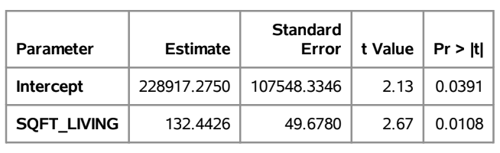
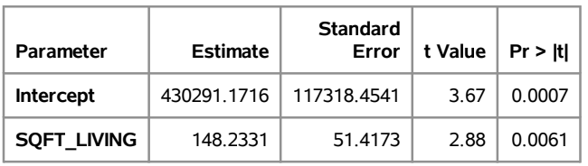
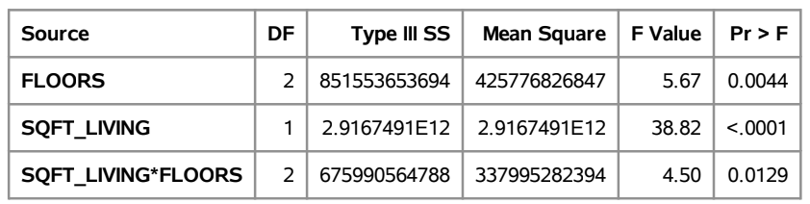
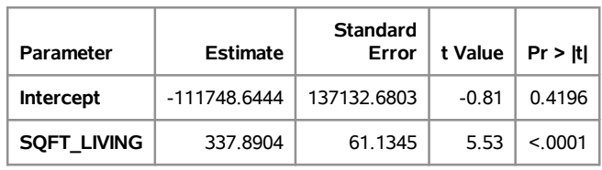
Homogeneity of Regression Slopes:
We see an interaction between covariate and the independent variable. So the homogeneity of regression slopes assumption is not tenable and we cannot proceed with an ANCOVA analysis.

Slide 24
CRAC (Completely Randomized Analysis of Covariance)
2. Factor: Bedrooms Covariate: Sqft_living
Factor: Bedrooms
Covariate: Sqft_living
Dependent Variable : Price
Our covariate has a positive correlation of 0.495 with the dependent variable Price
We wish to see if the factor Bedrooms has a significant effect on Price after accounting for the effects of the covariate.
Notes:
Swithin

Slide 25
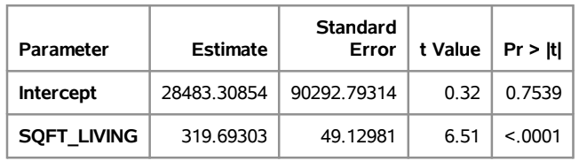

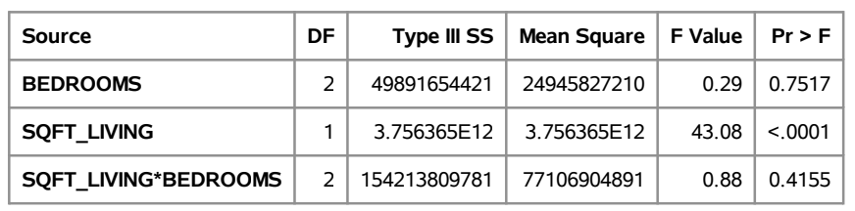
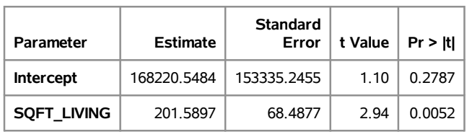
Homogeneity of Regression Slopes:
Even though there is variation in regression slopes across the different levels in Factor Bedroom, the variation is not statistically significant because the interaction between the covariate and the Factor has a p-value of 0.4155. So, the homogeneity of regression slopes assumption is tenable.

Slide 26
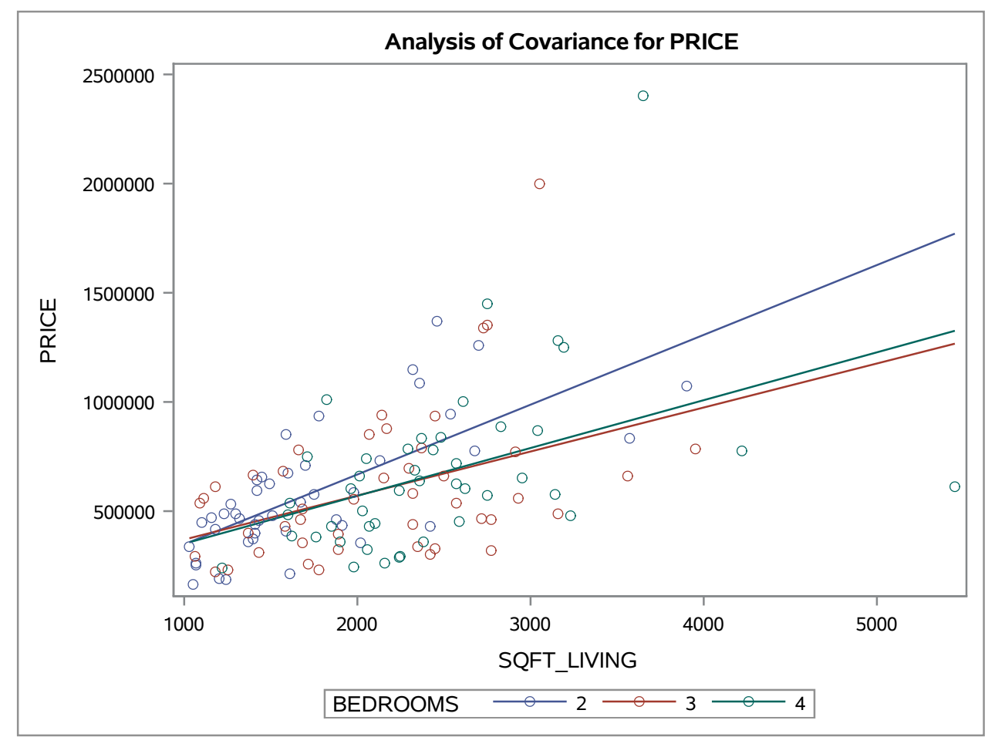
Regression Slopes for Bedroom

Slide 27
Null hypothesis:
Ho: μ_{B=2}= μ_{B=3}= μ_{B=4}
Alternate hypothesis:
Ha: μ_{i}≠μ_{j} For at least one combination of i and j
Where i and j represent the number of bedrooms

Slide 28
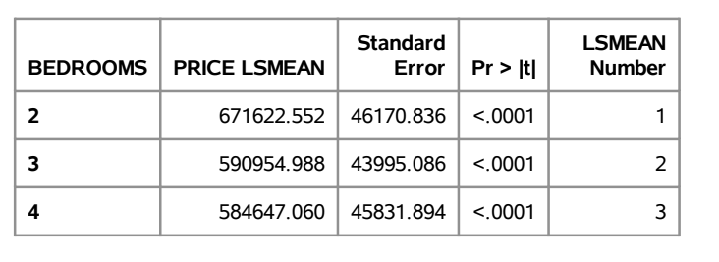
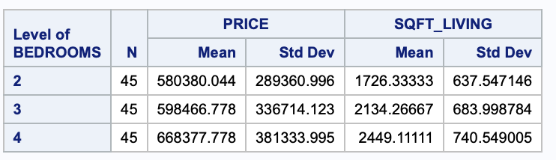
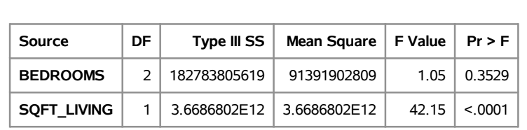
From Type 3 Analysis, we see that the levels in Bedrooms still does not have significance after accounting for the effects of the covariate. So we fail to reject the Null Hypothesis. Compared to the corresponding CRD design, the p-value for Bedrooms is higher i.e. we see that when we account for the covariate Bedrooms are more significant than was inferred in the CRD design - Still not statistically significant

Slide 29
Key Results
First, we wished to find out if the Factor Bedrooms had any significant differences
According to the CRD design output, the levels in the factor Bedrooms did not have significance.
We did the CRD design with Floors as the main Factor. We found out that Houses with 1.5 Floors had a significantly higher mean Price compared to other types
Then we did two RBD designs with an added explanatory blocking Factor Grades which also gave us results consistent with the corresponding CRD designs
Then we performed a Completely Randomized Factorial Design with the Factors Floors and Bedrooms. We found out that there were no significant interactions betweens the factors. Consistent with the other designs, the Factor Floors had significance and Bedrooms did not.
We added the Blocking Factor Grade to the CRF design to see if the addition of the Blocking Factor changes our conclusions on the Significance two factors. The RBF design results were also consistent with that of CRF
Then we carried out two separate ANCOVA analyses with the main Factor as Bedrooms, Floors with Sqft_living as a covariate. Our key inferences were still consistent with the corresponding CRD designs.
Overall, we conclude that 1.5 floors have a significantly higher mean price than the other homes.
Notes:
Tianfeng
Recommendation is for a better modelling approach next time

Slide 30
Thank You

